Slide 1



Slide 2

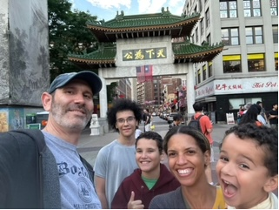
Meet Your Teacher
This is my 20th year at KLES. I taught 3rd grade for 14 years and this will be my fifth year teaching 4th grade. I am married to Ben Browning and have three boys, Alex (17) a senior at Chiles, Brayden (12) a 7th grader at Deerlake and Camden (4).

Slide 3

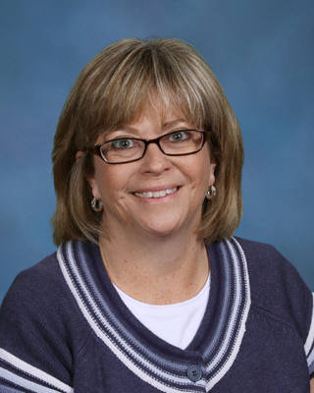
Math and Social Studies Teacher
Mrs. Garcia
Room 604

Slide 4

THINGS TO DO
Sign in and take your “to go” information packet
2. If you are Browning Homeroom fill out and return two forms on counter and place in designated tray
-Student Information
- Transportation Form
3. View Language Arts and Science Books
(front table)
4. Visit Mrs. Garcia (room 604)

Slide 5


Slide 6

Lunch is from
12:34-12:59
Special Area is from
1:00-1:45

Slide 7

Snack
-We will have a working snack.
-Please bring a small, nutritious, non-messy snack to eat while we work.
-Water should be in a closable bottle.

Slide 8

Special Area Rotation
Day 1 PE
Day 2 Science
Day 3 Media
Day 4 PE
Day 5 Music
Day 6 Art
*Students will go to guidance instead of media for the 2nd and 4th grading periods*

Slide 9

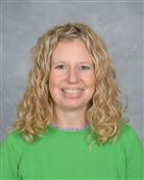
Music Teacher
Mrs. Pursino

Slide 10

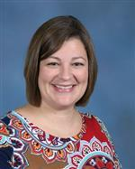

Media Specialist
Mrs. Stemle

Slide 11
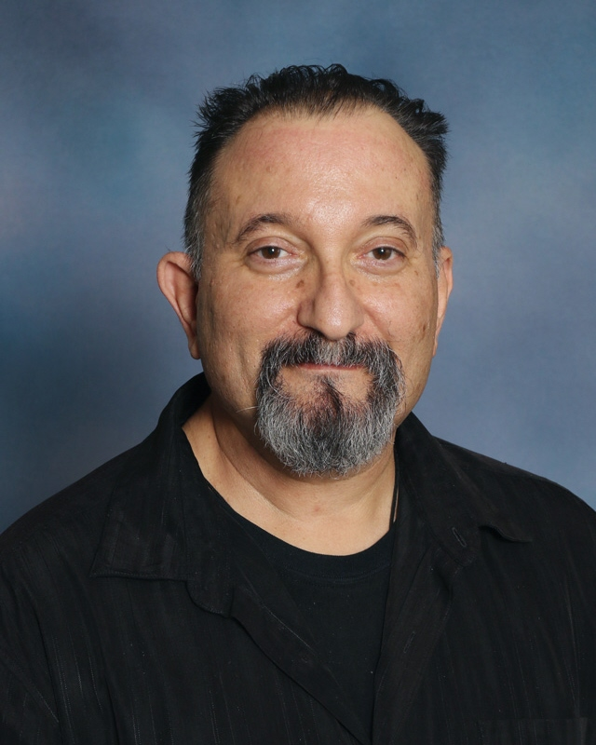
Art Teacher
Mr. Tavares

Slide 12

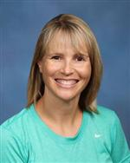
PE Teacher
Mrs. Hickman

Slide 13


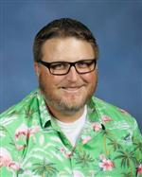
A+
Science Teacher
Mr. Piotrowski

Slide 14


See you Monday!
* The bell rings at 8:25 AM.
* Students that arrive before 8:00 go to the
cafeteria. Note: Supervision does not begin
until 7:45am.
*Children arriving after 8:00am will come to my room for the first two days of school. Beginning August 14th students will go to the intermediate playground (basketball courts). I will pick them up from there.
*If you are doing gate pickup at the end of the day, meet your child at the 4th grade gate by the EDEP office in front of the school.

